Slide 1
Input Tax Credit

Slide 2
This presentation covers only those Input tax credit topics which are not covered in the class.
In our last class on ITC, we have covered Section 16(1), 16(2), Reversal of ITC due to non-payment of consideration, ITC where invoices are not uploaded by supplier, 16(3), 16(4) and Blocked credit Section 17(5)

Slide 3
Section 17(1), CGST Act, 2017
Where input goods or services are used partly for business purposes and partly for non-business purposes
Proportionate credit is available in this case. ITC would be available to an extent that is attributable for business purposes.

Slide 4
Section 17(2), CGST Act, 2017
Where input goods or services are used partly for effecting taxable supply and partly for exempted supply
Proportionate credit is available in this case. ITC would be available to an extent that is attributable in respect of inputs used for providing taxable supplies including zero-rated supplies.
For example, If common ITC* is Rs.10,000, turnover of taxable and exempted supply are Rs. 6,00,000 and Rs. 4,00,000 respectively.
Then ITC allowed would be:
(6,00,000/10,00,000) X 10,000 =Rs. 6000
*Note to students: Common ITC calculation would be covered in subsequent slides.

Slide 5
For the purposes of this section, exempted supplies include
-Supplies on which recipient is liable to pay tax under RCM
- Transactions in securities
- Sale of land and sale of building (when entire consideration is received after completion certificate)*
- Nil-rated supplies
-Non-taxable supplies
NO ITC IS AVAILABLE IN RESPECT OF INPUTS EXCLUSIVELY USED FOR EFFECTING EXEMPT SUPPLIES OR USED EXCLUSIVELY FOR NON-BUSINESS PURPOSES, OR USED EXCLUSIVELY FOR EFFECTING NON-TAXABLE SUPPLIES.
Note to students: These supplies are covered under Schedule III. This means that these are neither treated as supply of goods nor supply of services. It is included in the meaning of “exempted supplies for the purpose of Section 17(2)” just to avoid any confusion.

Slide 6
Section 17(4)
ITC in case of Banks or Financial Institutions including NBFCs engaged in supplying services by way of accepting deposits or providing loans or advances
These institutions have the option of
Either follow the provisions as per Section 17(2)
Or
2. Avail 50% of the eligible input tax credit on input goods, services and capital goods for every month. Rest of the ITC will lapse.
Please note that if any financial institution opts for second option, then this 50% limit will not be applicable on input supplies between registered persons having same PAN. For instance, a bank in Delhi receiving input services from its branch in Maharashtra (assuming both have same PAN), then 100% ITC would be allowed on this input supply.

Slide 7
Important points
This option 2 must be exercised by the financial institutions before the beginning of the financial year. Once the option is exercised, it can not be withdrawn in the middle of the financial year.

Slide 8
Rule 42(1) APPORTIONMENT OF COMMON CREDIT
Manner of determination of ITC in respect of input or input services partly used for business purposes and partly for other purposes as per Section 17(1) OR partly for effecting taxable supplies and partly for effecting exempted supplies as per Section 17(2)
If inputs are exclusively used for non-business purposes or exclusively for effecting exempted supplies, then, one can easily determine the amount of ITC which is not allowed.
This rule covers common credits i.e. where inputs are used partly for business purpose and partly for non-business purpose (or partly for effecting taxable supplies and partly for effecting exempted supplies.

Slide 9
STEP-1: To find out ITC credited to electronic credit ledger
Total input tax on input goods/ services during a tax period XX
(Less)
Input tax exclusively used for non-business purposes (XX)
Input tax exclusively for making exempt supplies (XX)
Input tax pertaining to inputs covered under Blocked credit as per section 17(5) (XX)
---------------------------------------------------------------------
ITC credited to electronic credit ledger: XX (Lets name it C1)

Slide 10
STEP-2: To find out Common credit
ITC in respect of inputs exclusively used for effecting taxable supplies including zero-rated supplies :T (naming it T)
Common credit (naming it C2) = C1 - T
STEP-3: Computation of Inadmissible credit as per Rule 42
Aggregate value of exempt supplies in the tax period: EX
Total turnover in a tax period: TT
Credit attributable to exempt supplies: A= (EX/TT) X C2
Credit attributable to non-business purposes: It is taken as 5% of C2. lets name it B
Total inadmissible credit = A + B
Note: This inadmissible credit must be reversed by the registered person in FORM GSTR3B.

Slide 11
STEP 4: Computation of eligible common credit and total credit eligible
Eligible Common credit (naming it X) = C2- (A+B)
Eligible credit = Eligible common credit + ITC exclusively used for effecting taxable supplies
= X + T

Slide 12
Section 18(1)(a) Fresh registration
A person who has applied for registration within 30 days of becoming liable for registration is entitled to ITC of input tax in respect of goods held in stock (or inputs contained in semi-finished or finished goods) on the day immediately preceding the date from which he becomes liable to pay tax.
Important point: A registered person shall not be entitled to take ITC in respect of any supply of goods/ services to him after the expiry of 1 year from the date of issue of tax invoice relating to such supply. In this case, ITC is not available on capital goods.

Slide 13
Section 18(1)(b) Voluntary registration
A person who has taken voluntary registration is entitled to ITC of input tax in respect of goods held in stock (or inputs contained in semi-finished or finished goods) on the day, immediately preceding the date of registration.
Important note: A registered person shall not be entitled to take ITC in respect of any supply of goods/ services to him after the expiry of 1 year from the date of issue of tax invoice relating to such supply. In this case, ITC is not available on capital goods.

Slide 14
Section 18(1)(c)
Shifting from Composition scheme to normal scheme
A person switching over to normal scheme from composition scheme under section 10 is entitled to ITC in respect of goods held in stock (or inputs contained in semi-finished or finished goods) and capital goods on the day immediately preceding the date from which he becomes liable to pay tax as normal taxpayer.
A registered person shall not be entitled to take ITC in respect of any supply of goods/ services to him after the expiry of 1 year from the date of issue of tax invoice relating to such supply.

Slide 15
In this case, ITC is available on capital goods but depreciation for use of capital asset till the time registered taxpayer was covered under composition scheme must be allowed. Calculation of available ITC will be as follows- Total ITC on capital goods gets reduced by 5% for use of every quarter or part thereof. Quarter of the year to be computed in terms of three consecutive calendar months i.e. quarter ending March, June, September and december of the calendar year.
For example, Capital good such as machinery was purchased on 18/08/2017 and CGST and SGST was Rs. 24,000 each. Registered taxpayer was covered under composition scheme. He becomes eligible to pay tax under normal scheme w.e.f. 10th July, 2018. As per the Section 18(1)(c), this taxpayer is eligible to claim ITC on capital goods. Computation of ITC available to be done as follows-
5% depreciation for 5 quarters (July-sep, 2017, oct –dec,2017, Jan-march,2018, April-june2018 and July-sept, 2018)=
[5/100 x 48000 x 5] =12,000
ITC available= Rs. 36,000; (CGST and SGST= 18,000 each)

Slide 16
Section 18(1)(d)
When an exempt supply becomes a taxable supply
Where an exempt supply of goods or services or both become taxable, the person making such supplies shall be entitled to take ITC in respect of goods held in stock (or inputs contained in semi-finished or finished goods) and capital goods held on the day immediately preceding the date from which supply becomes taxable.
In this case, ITC is available on capital goods but depreciation for use of capital asset till the time supply was exempt supply must be allowed. Calculation of available ITC to be done as mentioned in previous slides.

Slide 17
A registered person shall not be entitled to take ITC in respect of any supply of goods/ services to him after the expiry of 1 year from the date of issue of tax invoice relating to such supply.

Slide 18
Section 18(4)
Switching to Composition Scheme or taxable supplies become exempt supplies
A person switching over from composition scheme under section 10 to normal scheme or where a taxable supply become exempt, the ITC availed in respect of goods held in stock (or inputs contained in semi-finished or finished goods) as well as capital goods on the day immediately preceding the date of exercising section 10 or the date of exemption of supply, as the case may be must be reversed.
Reversal of ITC may happen by way of debit in electronic credit ledger or electronic cash ledger. After reversal from electronic credit ledger, if any balance is left in that ledger, then it shall lapse.

Slide 19
Computation of Reversal of ITC on capital goods to be done as follows- [This method is different from the calculations as done in Section 18(1)(c) and 18(1)(d)] Under this method, useful life of capital asset is assumed as 60 months, which is fixed by law.
Illustration in the next slide would be useful inunderstanding the calculation

Slide 20
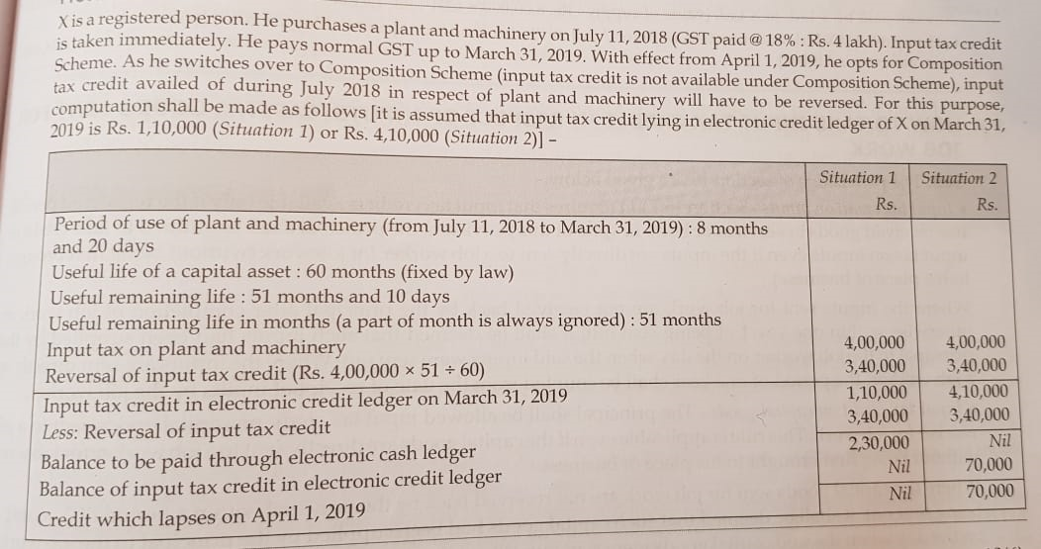
Source: Dr. V.K. Singhania, GST and Customs Laws book, Taxmann

Slide 21
Section 18(6) Removal of capital goods
In case capital goods or plant and machinery, on which ITC is taken, is supplied to another person, then reversal of ITC takes place.
Reversal of ITC on removal of capital goods shall be:-
--an amount equivalent to ITC availed minus the reduction as prescribed in rules (5% for every quarter or part thereof)*
or
--tax on transaction value of the supply,
WHICHEVER IS MORE
*Note: this computation is done in the same manner as mentioned in section 18(1)(c) and 18(1)(d)

Slide 22
Important Point:
Where refractory bricks, moulds and dies, jigs and fixtures are supplied as scrap, the taxable person may pay tax on transaction value of such goods (by ignoring first point of the previous slide i.e. 5% for every quarter)

Slide 23
References and Suggested readings
Books:
CA K.M. Bansal, GST & Customs Laws, Taxmann
Dr. V.K. Singhania, GST and Customs Laws, Taxmann
E-resources:
http://cbic.gov.in/resources//htdocs-cbec/gst/ITC%20_Mechanism.pdf

